Slide 1
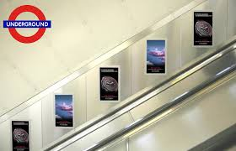
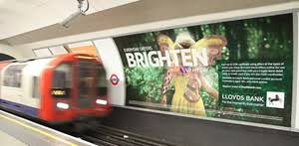
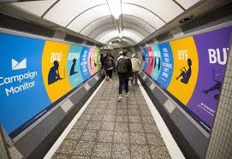
A data science approach for an purchasing strategy for advertising at London Underground Stations

Slide 2
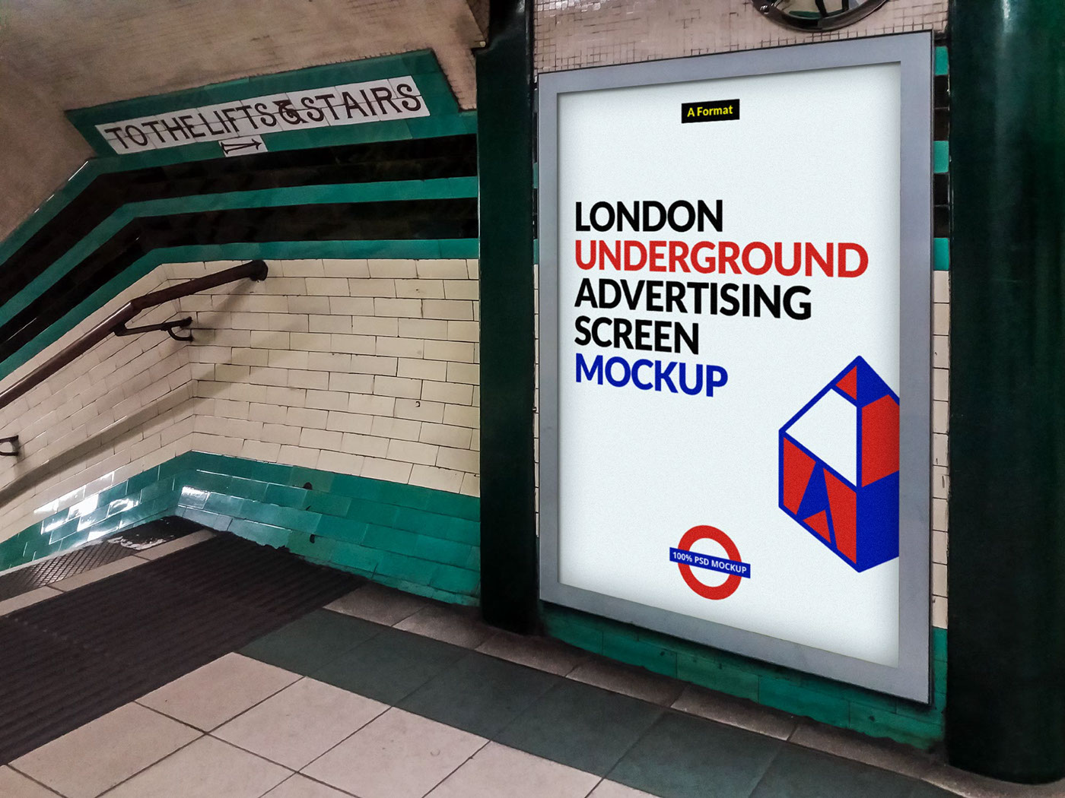
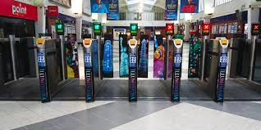
Business Problem
This project is aimed at assisting advertising agencies identify at which groups of London Underground Stations (LUS) they should buy advertising space.
Buying advertising space for groups of stations will save money.

Slide 3

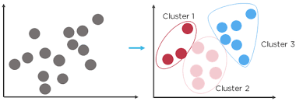
Approach
Foursquare
Clustering Analysis

Slide 4
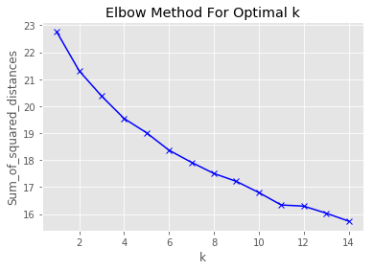
Analysis: the opitmum number of clusters
The change in gradient is greatest where k is 11

Slide 5
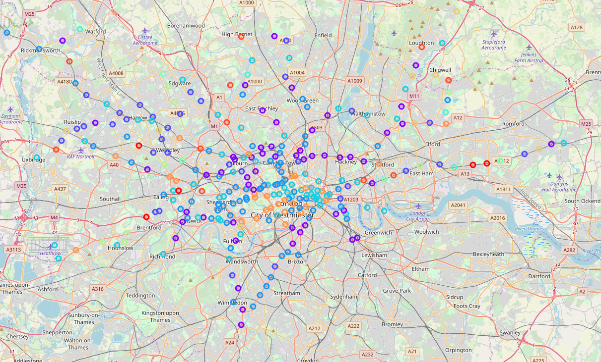
Map of the London Underground Stations – clusters colour coded

Slide 6
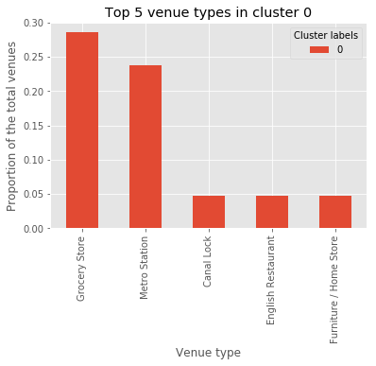
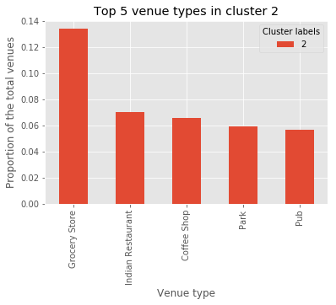
The LUSs associated with Grocery Stores
Proposed advertising space purchasing strategy:
Food
Number of LUSs = 37

Slide 7
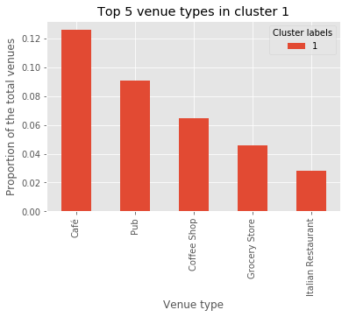
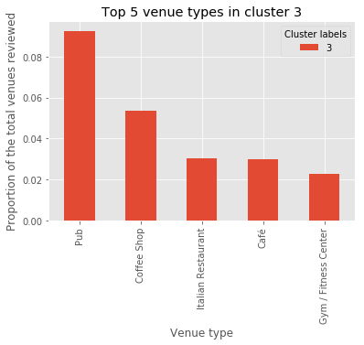
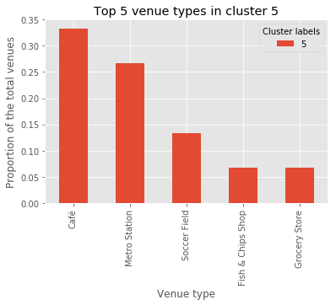
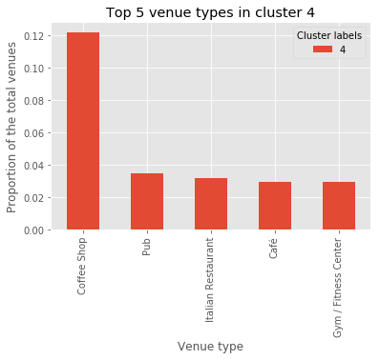
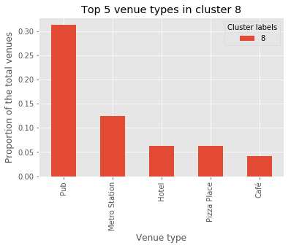
The LUSs associated with pubs, coffee shops and cafes
Proposed advertising space purchasing strategy:
Alcohol
Activities such as holidays
Dating applications
Number of LUSs = 201

Slide 8
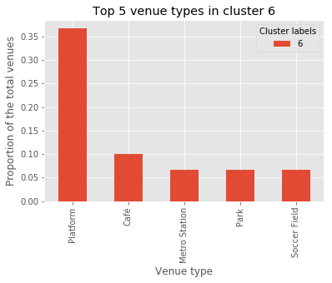
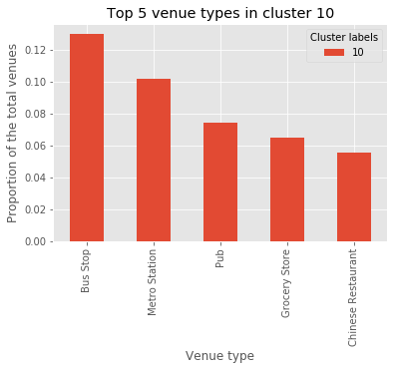
The LUSs associated with transport infrastructure
Proposed advertising space purchasing strategy:
Adverts requiring longer reading time;
Books
Snacks
Number of LSUs = 16

Slide 9
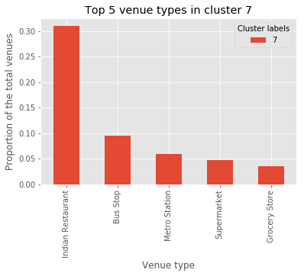
The LUSs associated with Indian restuarants
Proposed advertising space purchasing strategy:
Foreign holidays
Exotic food and drink
Alcohol
Number of LUSs = 20

Slide 10
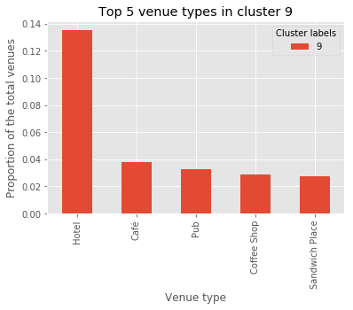
The LUSs associated with hotels
Proposed advertising space purchasing strategy:
Network providers
Restaurants
Local visitor attractions
Number of LUSs = 29

Slide 11


Conclusions:
A data science approach can be used to create an evidence based strategy for the purchasing of advertising space
I recommend an experiment to evaluate whether the proposal works, and that the results should be reviewed six months after it has been implemented.

